Slide 1
Tableau Basics for charts and maps
Ramesh Ragala

Slide 2
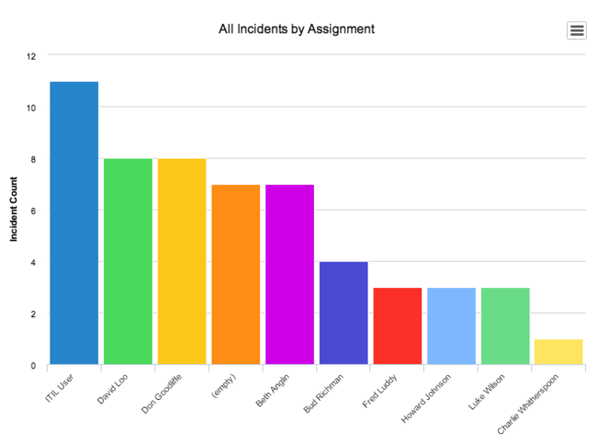


Bar Charts
Bar charts are used to compare data across different categories.
Creation of bar charts in tableau
Placing Dimension on the Rows shelf
Placing the measure on the Column shelf
Vice – versa
Vertical bar
Horizontal bars

Slide 3
Bar charts
Mechanism to create bar charts in tableau:
Connect to the sample – super store data source
Drag the Order Date dimension to Columns.
This data is aggregate by year and headers appear.
Drag the Sales measure to Rows
The measure is aggregated as a sum and an axis is created.
The column headers move to the bottom of the view.
Tableau uses Line as the mark type because you added the date dimension.

Slide 4
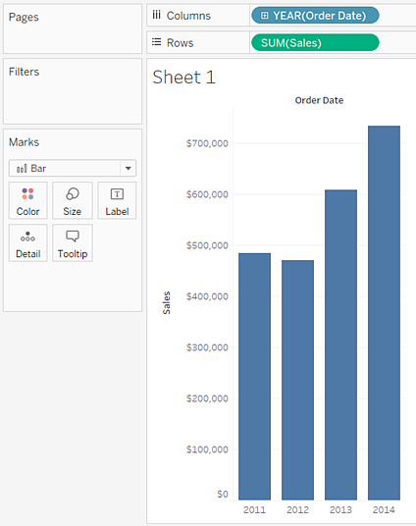
Bar charts
Mechanism to create bar charts in tableau:
On the Marks card, select Bar from the drop-down list.
The axis is vertical
The length of the each mark
Represents the sum of the
Sales for that year
2014 → $60,474

Slide 5
Bar charts
Mechanism to create bar charts in tableau:
Drag the ship mode dimension on the Color on the mark card. → check the visualization
Drag the Region dimension to Rows, and drop it to the left of Sales to produce multiple axes for sales by region. → check the visualization.
Want to view the data in Central region only. → we have to use filters.
Drag the Region dimension from the Data pane to the Filters shelf.
In filter shelf, uncheck all except Central region.
Ship mode changed in the central over the four year period.

Slide 6
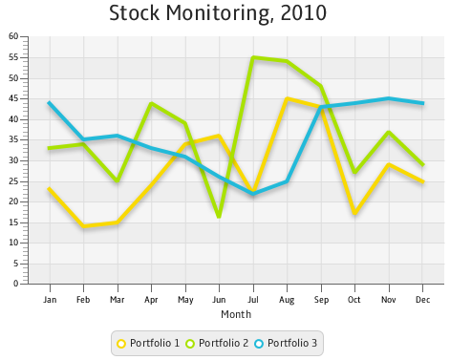
Line charts
Line charts connect individual data points in a view.
used to visualize a sequence of values.
Useful to check the trends over time.
Useful to forecast feature values

Slide 7
Line charts
Mechanism to create Line charts in tableau:
Connect to the Sample - Superstore data source.
Drag the Order Date dimension to Columns
Drag the Sales measure to Rows.
Drag the Profit measure to Rows and drop it to the right of the Sales measure.
Drag the SUM(Profit) field from Rows to the Sales axis to create a blended axis.
The two pale green parallel bars indicate that Profit and Sales will use a blended axis when you release the mouse button.

Slide 8
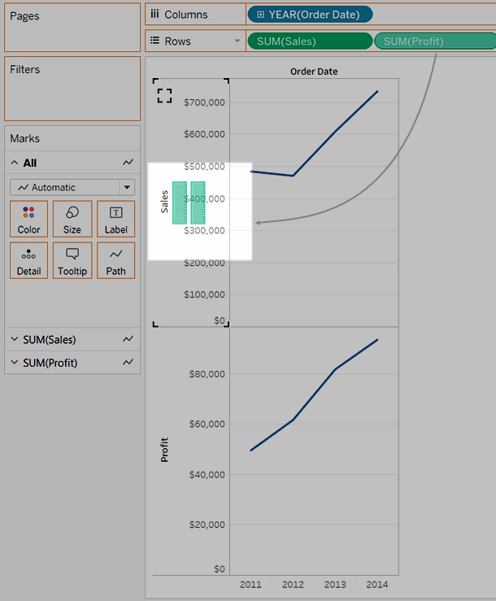
Line Charts

Slide 9
Line charts
Mechanism to create Line charts in tableau:
Click the drop-down arrow in the Year(Order Date) field on the Columns shelf and select Month in the lower part of the context menu.
To add a forecast, go to Analytics pane, drag the Forecast model to the view, and then drop it on Forecast.

Slide 10
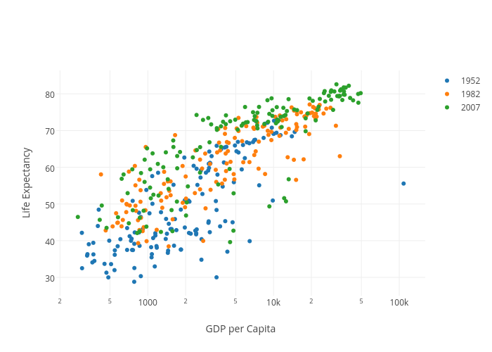
Scatter Plot
It is used to visualize relationships between numerical variables.
A scatter plot can be created by placing at least one measure on the Columns shelf and at least one measure on the Rows shelf in tableau.

Slide 11
Scatter Plot
Creation of scatter plots in tableau:
Connect to the Sample - Superstore data source.
Drag the Profit measure to Columns
Drag the Sales measure to Rows.
Drag the Category dimension to Color on the Marks card.
Drag the Region dimension to Detail on the Marks card.
To add trend lines, from the Analytics pane, drag the Trend Line model to the view, and then drop it on the model type.
Cursor over the trend lines → shows the statistical information about the model that was used to create the line

Slide 12
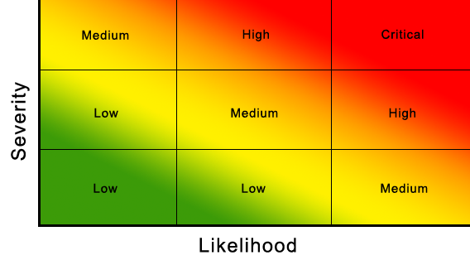
Heat maps
Heat maps are used to compare categorical data using color.
Heat maps can be created in tableau, by placing one or more dimensions on the Column shelf and one or more dimensions on the row shelf.
Select the square as the mark type
Place a measure of interest on the color shelf

Slide 13
Heat maps
Heat map generation in tableau:
Connect to the Sample - Superstore data source.
Drag the Segment dimension to Columns.
Drag the Region and Sub-Category dimensions to Rows, dropping Sub-Category to the right of Region.
Drag the Profit measure to Color on the Marks card.
Optimize view format:
On the Marks card, select Square as the mark type.
Make the columns wider by pressing Ctrl + Right arrow
Increase the mark size by pressing Ctrl + Shift + B

Slide 14
Heat maps
Heat map generation in tableau:
Optimize view format:
Highlighted the Central region using filter.
Click on the regions in row shelf → select central only.
In central region →
copiers are shown to be the most profitable sub-category
binders and appliances the least profitable
Click Color on the Marks card to display configuration options.
In the Border drop-down list, select a medium gray color for cell borders
The default color palette is Orange-Blue Diverging.

Slide 15
Heat maps
Heat map generation in tableau:
Optimize view format:
A Red-Green Diverging palette might be more appropriate for profit.
Hover over the SUM(Profit) color legend, then click the drop-down arrow that appears and select Edit Colors.
In the Edit Colors dialog box, in the Palette field, select Red-Green Diverging from the drop-down list.
Select the Use Full Color Range check box and click Apply and then click OK.
Drag the Sales measure to Size on the Marks card to control the size of the boxes by the Sales measure
compare absolute sales numbers (by size of the boxes) and profit (by color).
To enlarge the marks, click Size on the Marks card to display a size slider:

Slide 16
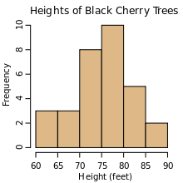
Histograms
It is a chart that displays the shape of a distribution.
A histogram looks like a bar chart but groups values for a continuous measure into ranges, or bins.
Histogram creation in tableau:
Connect to the Sample - Superstore data source
Drag Quantity to Columns.
Click Show Me on the toolbar, then select the histogram chart type.

Slide 17
Histograms
Histogram creation in tableau:
The histogram chart type is available in Show Me when the view contains a single measure and no dimensions.
Three things happen after you click the histogram icon in Show Me:
The view changes to show vertical bars, with a continuous x-axis and a continuous y-axis.
The Quantity measure which is placed on the Columns shelf, which had been aggregated as SUM, is replaced by a continuous Quantity (bin) dimension.
The Quantity measure moves to the Rows shelf and the aggregation changes from SUM to CNT (Count).

Slide 18
Histograms
Histogram creation in tableau:
Want to identify the relationship between the customer segment (consumer, corporate, or home office) and the quantity of items per order.
Drag Segment to Color.
Want to know the % of each bar that belongs to each segment.
Hold down the CtrlKey and drag the CNT(Quantity) field from the Rows shelf to Label.
Right-click the CNT(Quantity) field on the Marks card and select Quick Table Calculation → Percent of Total.
Want to see the % to be on a bar basis.
Right-click the CNT(Quantity) field on the Marks card again and select Edit Table Calculation.

Slide 19
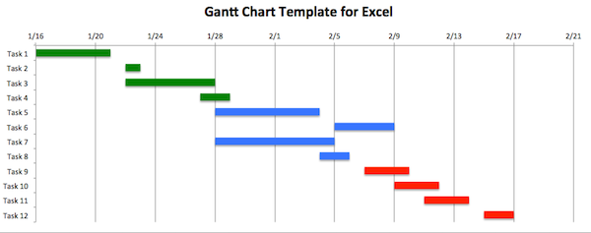
Gantt Charts
Gantt charts are used to show the duration of events or activities.
Creation of Gantt charts in Tableau:
Connect to the Sample - Superstore data source.
Drag the Order Date dimension to Columns.
On the Columns shelf, click the Year (Order Date) drop-down arrow, and then select Week Number.
Drag the Sub-Category and Ship Mode dimensions to the Rows shelf.
Drag the Ship Mode dimensions on the Color Mark.

Slide 20
Gantt Charts
Creation of Gantt charts in Tableau:
We will size the marks according to the length of the interval between the order date and the ship date.
To do this create a calculate field to capture the interval.
In the toolbar menu, click Analysis → Create Calculated Field.
In the calculation dialog box, name your calculated field OrderUntilShip.
Clear any content that's in the Formula box by default.
In the Formula box, enter the following formula and then click OK: DATEDIFF('day',[Order Date],[Ship Date])
The formula creates a custom measure that captures the difference between the Order Date and Ship Date values, in days.

Slide 21
Gantt Charts
Creation of Gantt charts in Tableau:
We will size the marks according to the length of the interval between the order date and the ship date.
Drag the OrderUntilShip measure to Size on the Marks card.
Right-click the SUM (OrderUntilShip) field on the Marks card, and then select Measure (Sum) → Average
Hold down the Ctrlkey and drag the Week(Order Date) field from the Columns shelf to the Filter shelf.
In the Filter Field dialog box, select Range of Dates and then click Next.
Set the range to a three-month time interval, such as 1/1/2013 to 3/31/2013, and then click OK.

Slide 22
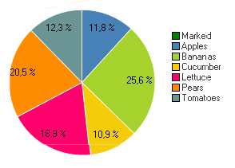
Pie Charts
Pie charts are mainly used to show the proportions.
Creation of pie charts in tableau:
Connect to the Sample - Superstore data source.
Drag the Sales measure to Columns.
Drag the Sub-Category dimension to Rows.
Click Show Me on the toolbar, then select the pie chart type.
To make the chart bigger, hold down Ctrl + Shift+B.
To add labels, drag the Sub-Category dimension from the Data pane to Label on the Marks card

Slide 23
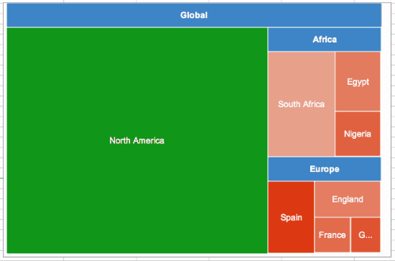
Tree Maps
Tree maps are used to display the data in nested rectangles.
We will use dimensions to define the structure of the tree map and measure are used to define the size or color of the individual rectangles.
In tree maps, size and color are important elements.
Tree Map creation in Tableau:
Connect to the Sample - Superstore data source
Drag the Sub-Category dimension to Columns.
Drag the Sales measure to Rows.
Click Show Me on the toolbar, then select the treemap chart type.
The size of the rectangles and their color are specifies the value of Sales

Slide 24
Tree Maps
Tree Map creation in Tableau:
Drag the Ship Mode dimension to Color on the Marks card.
Ship Mode determines the color of the rectangles and sorts them into four separate areas accordingly.
Sales determines the size of the rectangles
click the Undo button to remove Ship Mode from view. → another view
Drag the Profit measure to Color on the Marks card.
Profit determines the color of the rectangles and sales determines their size.

Slide 25
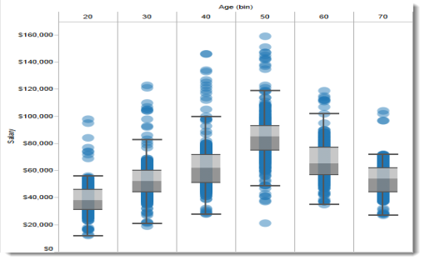
Box and Whisker plots
Box plots or box-and-whisker plots are used to show the distribution of data along an axis.
Box plots creation in tableau:
Connect to the Sample - Superstore data source.
Drag the Segment dimension to Columns.
Drag the Discount measure to Rows.
Drag the Region dimension to Columns, and drop it to the right of Segment.
Click Show Me in the toolbar, then select the box-and-whisker plot chart type.
To disaggregate data, select Analysis > Aggregate Measures.
Right-click on the bottom axis and select Edit Reference Line.
In Edit Reference Line, Band, or Box dialog box, in the Fill drop-down list, select an interesting color scheme.

Slide 26
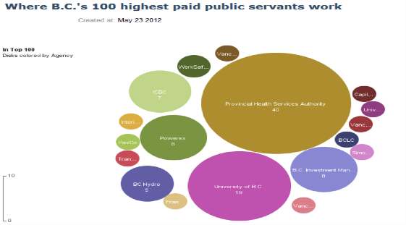
Bubble charts
Bubble charts are used to display data in a cluster of circles.
Dimensions defines the individual bubbles, and measures define the size and colour of the individual circles.
Bubble chart creation in tableau:
Connect to the Sample - Superstore data source.
Drag the Category dimension to Columns.
Drag the Sales measure to Rows.
Click Show Me on the toolbar, then select the packed bubbles chart type.
Drag Region to Detail on the Marks card to include more bubbles in the view.
Drag Profit to Colour on the Marks card
Drag Region to Label on the Marks card to clarify what each bubble represents.

Slide 27
Dash Board
First Worksheet: Profits
Double click on Longitude and Latitude in Measures
States in dimension tab into color markcard
Drag profit from measure tab into size card in markcard
Label the states → drag states from dimension tab and place it in label markcard
Category from dimension to filter markcard
Click on show filter

Slide 28
Dash Board
Second Worksheet: performance
Drag profit on rows shelf
Drag sales on row shelf
Drag order_date on column shelf → got to quarter
Drag region from dimension plane to filter markcard
Drag category from dimension plane to filter markcard
Drag sub-category from dimension plane to filter markcard
Click showfilter on all elements in filter markcard

Slide 29
Dash Board
Click on Dashboard icon to create new workbook for dashboard.
Select the listed worksheets on your dashboard
Check the filer on Right-side frame
Click on corresponding filter and apply this filter to selected worksheet by choosing appropriate option.

